Slide 1
National Suicide Prevention Conference 2017
Key themes

Slide 2
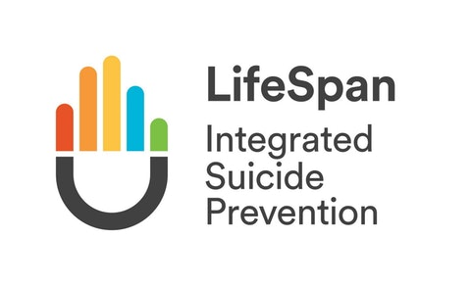
Systems approach endorsed
LifeSpan itself and some of the components (e.g. YAM schools program) were showcased by international keynote speakers as good examples of evidence based programs
Challenges:
Sustainability
Fidelity to evidence base
Universal interventions are very difficult to evaluate, but creative approaches are possible

Slide 3
Need more evidence!
Suicide Deaths & Attempts
Integrate / connect existing data sources (e.g. NCIS, ABS, police, health)
Suicide attempt data is particularly hard to capture
Can suicide prevention sector implements data capture systems similar to what is used in other areas of health
e.g. adverse effects following a vaccination
e.g. Hunter Toxicology registry

Slide 4
Need more evidence!
Interventions, Programs & Services
Evaluation as core business – build evaluation processes it into everything to allow more timely, accurate data collection.
Evaluation should include:
Process focus
Outcome focus
Interaction between process & outcome
Note: National Suicide Prevention Research Fund managed by Suicide Prevention Australia – no public announcements at conference, but application process likely to use NHMRC guidelines

Slide 5
Aboriginal & Torres Strait Islander Suicide Prevention
Dedicated Aboriginal & Torres Strait Islander suicide prevention stream occurring throughout conference
Emphasis on upstream issues (consistent with ATSISPEP report recommendations), e.g. Foetal Alcohol Syndrome Disorder (FASD), intergenerational trauma.
Need to strengthen families, which will in turn strengthen communities
Strong link between suicide prevention and human rights

Slide 6
Building support networks
Gatekeepers & local health professionals
Approximately 40% of people said they would not disclose suicidal thinking to anyone.
Those who do disclose often do so to a friend, intimate partner, psychologist or GP.
Most helpful response from psychologist or GP
Least helpful response from parent, inpatient staff, internet program
Mates in Construction – e.g. building workplace support
On-site support staff complete Applied Suicide Intervention Skills Training (ASIST)
Support staff are connected with and can call on local health professionals
Referral to National telephone support

Slide 7
Building support networks
Supporting those bereaved by suicide
Need proactive assistance (too overwhelmed to seek support and don’t know what support they need)
Most people looked for support online or asked their GP - often have difficulty finding the information
Increase social support / connections
Education on suicide bereavement for workplaces, GPs, counsellors
Connect with bereavement groups

Slide 8
Service delivery
Preparing services for increased demand
Services need to be prepared for increased demand when implementing community awareness activities, promoting help-seeking or introducing universal screening – if you are identifying and referring more people, you need to make sure the services can handle it.
Addressing suicide risk
Services support people with Eating Disorders (e.g. EDs, medical wards) are not necessarily addressing suicide risk, but instead focus on the person’s weight.

Slide 9
Service delivery
Role of Peer Work
Role of Peer Work was mentioned a number of times, but we’re not yet at a point where this is culturally self-sustaining. Instead, the successful integration of Peer Work and more traditional ‘clinical’ work is largely dependent on the organisation leadership at the time. That is, as soon as the leadership changes, the role of Peer Work can become vulnerable.

Slide 10
Use of Technology
Applications seem to have some impact on self-harm frequency and suicidal ideation, but results are not as sustainable for face-to-face treatments
Lower completion rates for treatment via phone apps than via face-to-face (50-60% versus 33%)
Approximately 75% of young people had attempted suicide reported some kind of suicide-related internet searching prior to their attempt

